Slide 1
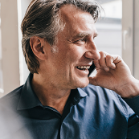
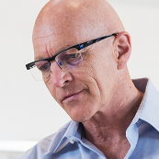





SSG Employee Chart
ALEXANDER MARTENSSON PET Technology
VICTORIA LINDQVIST Finance
VICTORIA LINDQVIST Dispatch
ALLAN MATTSSON Operations
KALLE PERSSON Production
MIRA NILSSON Executive Assistant
MIRA KARLSSON Project Manager
MIRJAM NILSSON SSG CEO
FLORA BERGGREN Facilities
IAN HANSSON VET
AUGUST BERGQVIST Reception
ANGELICA ASTROM VET
ALEXANDER MARTENSSON VET ASSISTANT

Slide 2
Workshop Participation
 | Workshop 1 | Workshop 2
October | 43 | 88
November | 23 | 6
December | 67 | 109

Slide 3
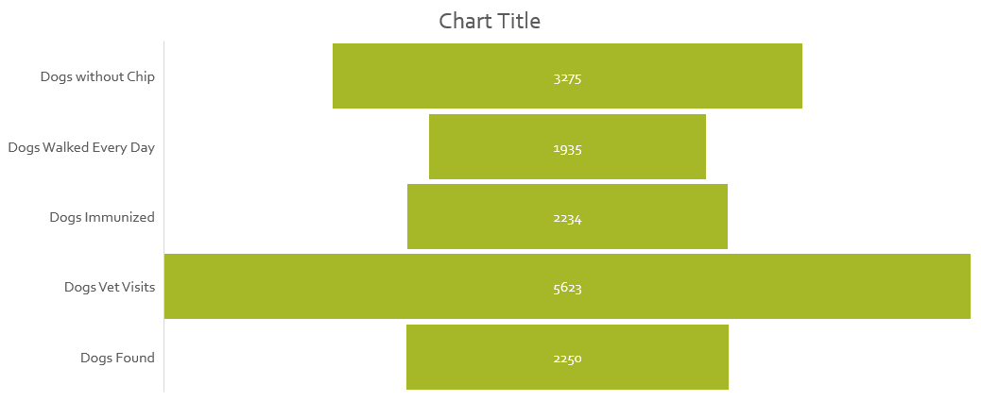
Pet Vet Statistics – First Quarter 2019

